Slide 1

Machine Learning
Dr. Abbas Malekpour

Slide 2

Type of Variables

Slide 3
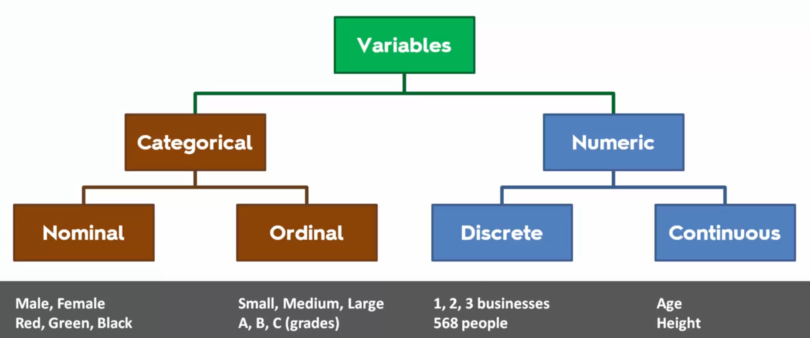
Type of Variables
Numerical and Categorical
Notes:
Target variable is Dependent Variable
All other features or variables are Independent variables

Slide 4
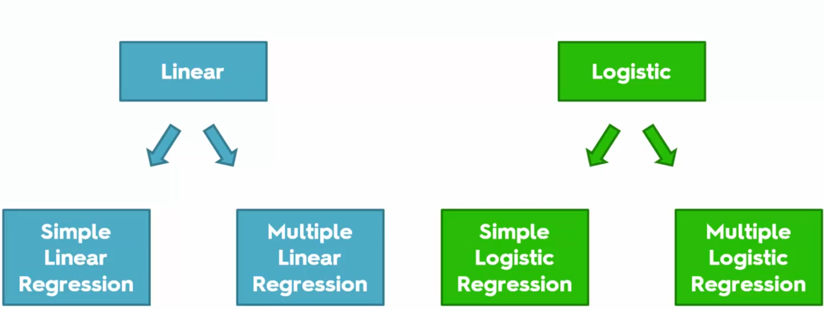
Regressions
Linear vs Logistic

Slide 5
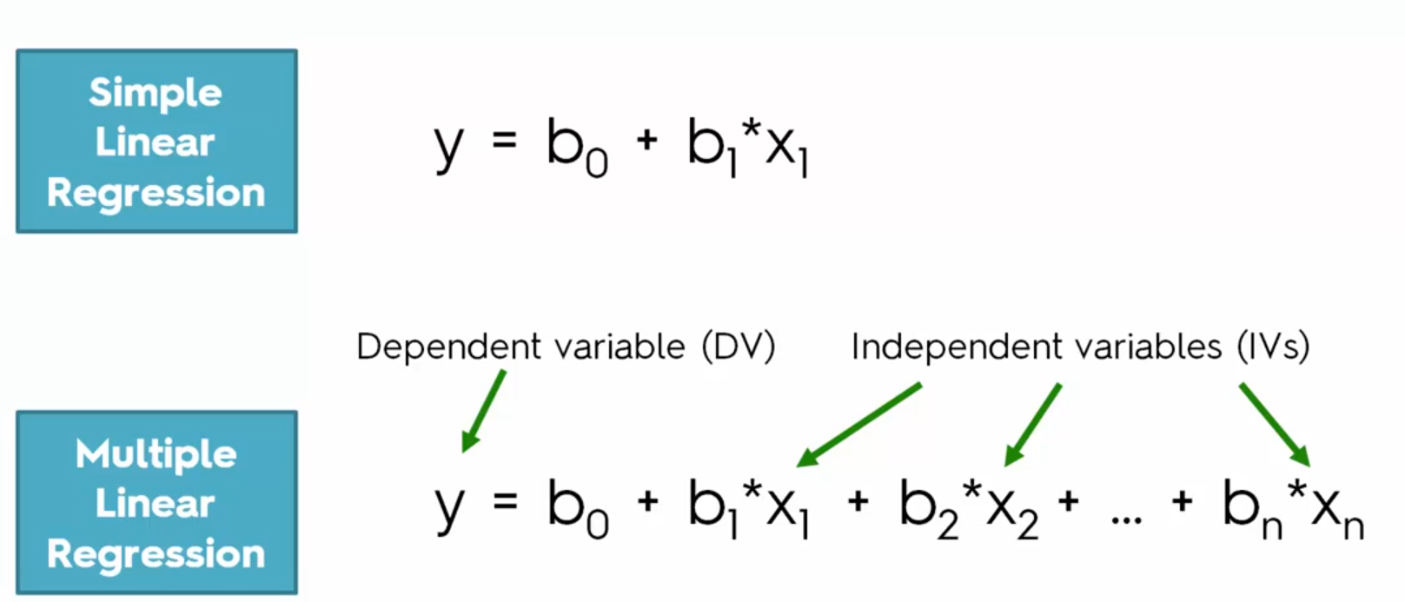
Equations
Simple vs Multiple Linear Regression

Slide 6
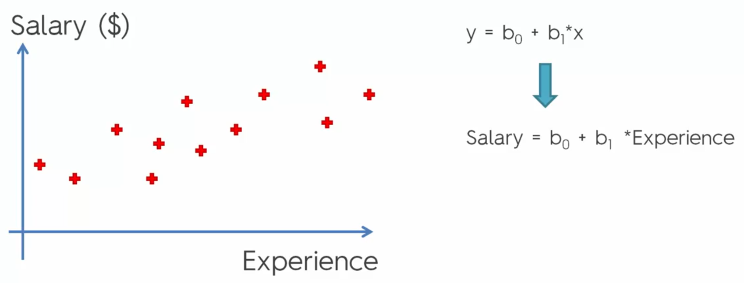
Simple Linear Regression
Salary and Experience

Slide 7
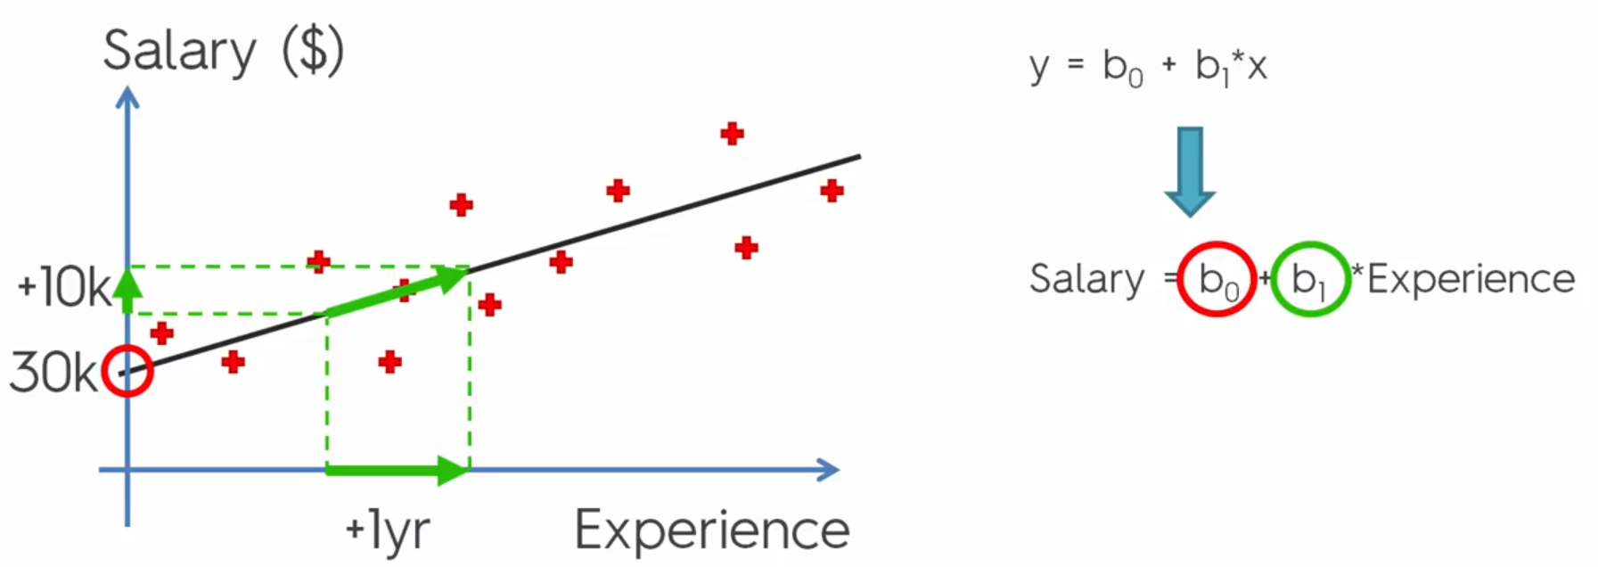
Simple Linear Regression – Continue
Linear Algebra
Notes:
B0 is Bias, B1 is the slop of the line

Slide 8
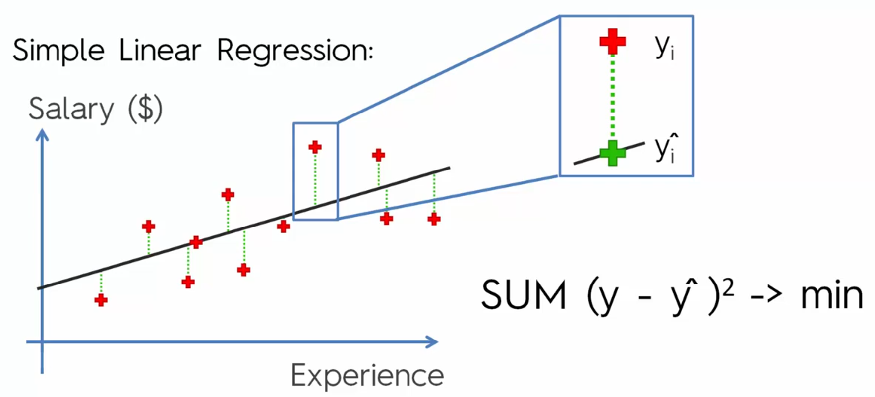
Ordinary Least Squares
Evaluation Models

Slide 9
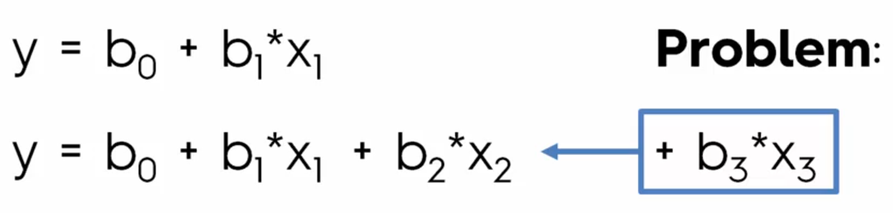
Adding Variable to reduce the ERROR rate
How many variable need to be added?

Slide 10
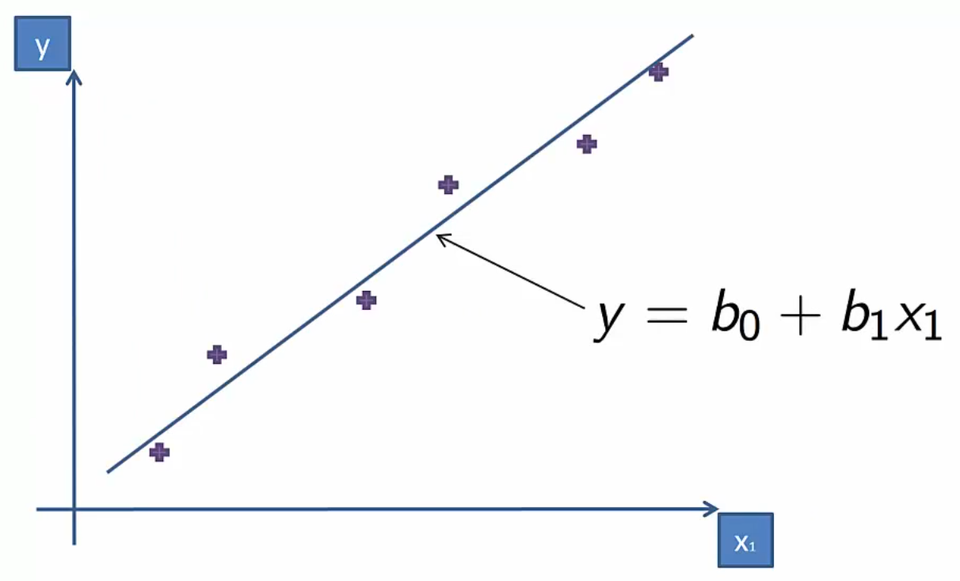
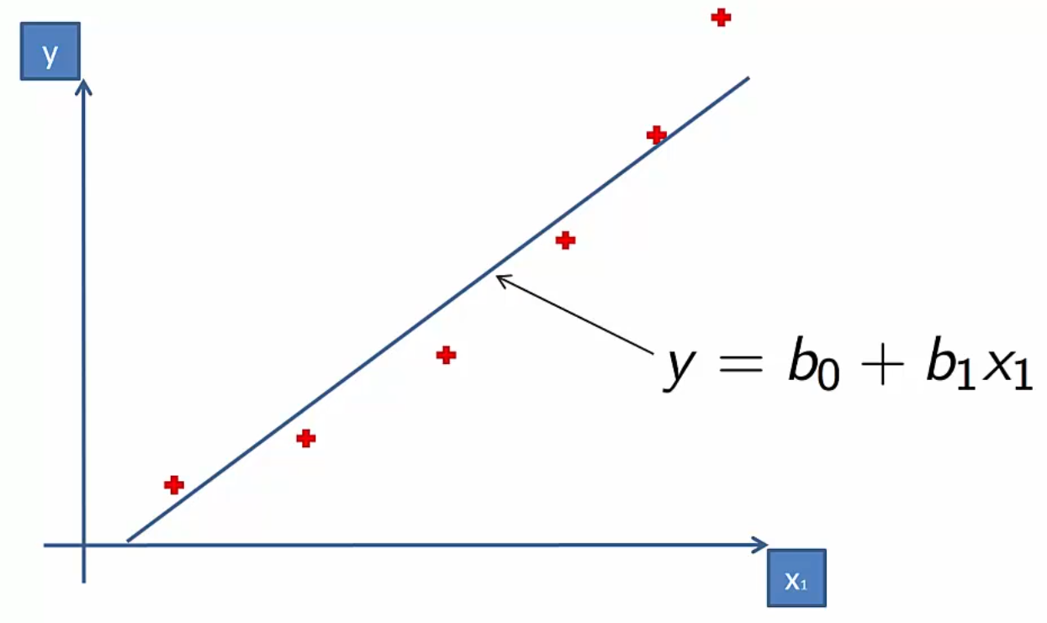
Notes:
Left fits well <> right does not fits well

Slide 11
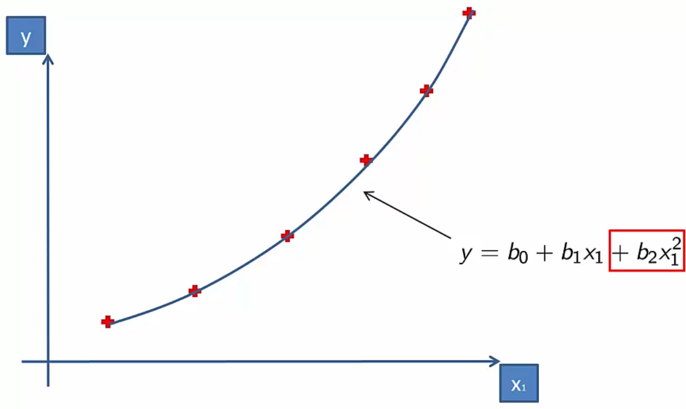
Why is called Linear?
Notes:
Coefficients are Linear!!

Slide 12
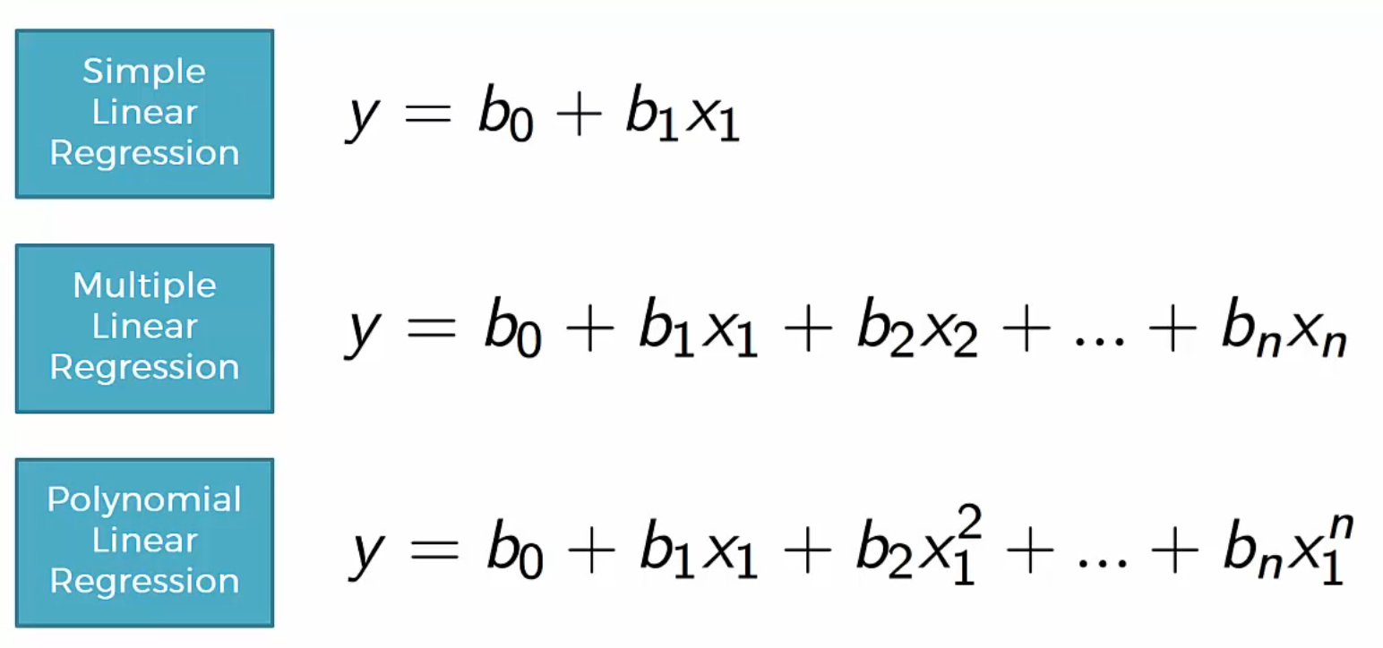
Single and Multi Variable vs Polynomial Linear Regression

Slide 13
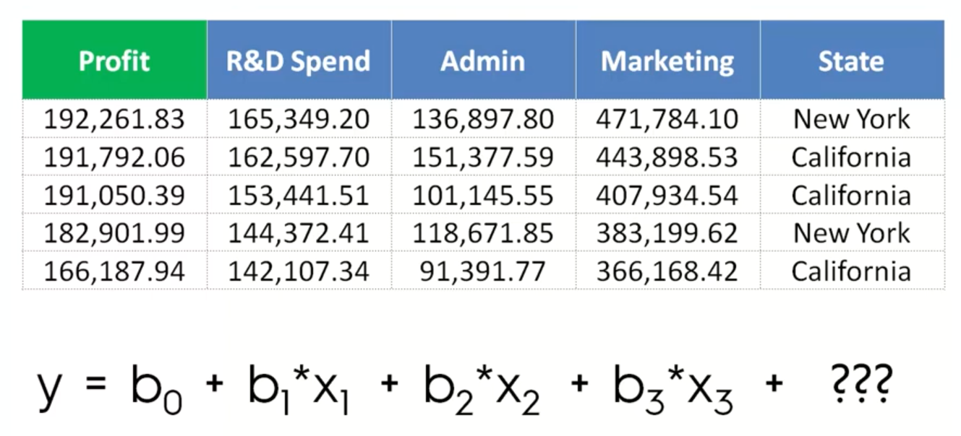

Slide 14
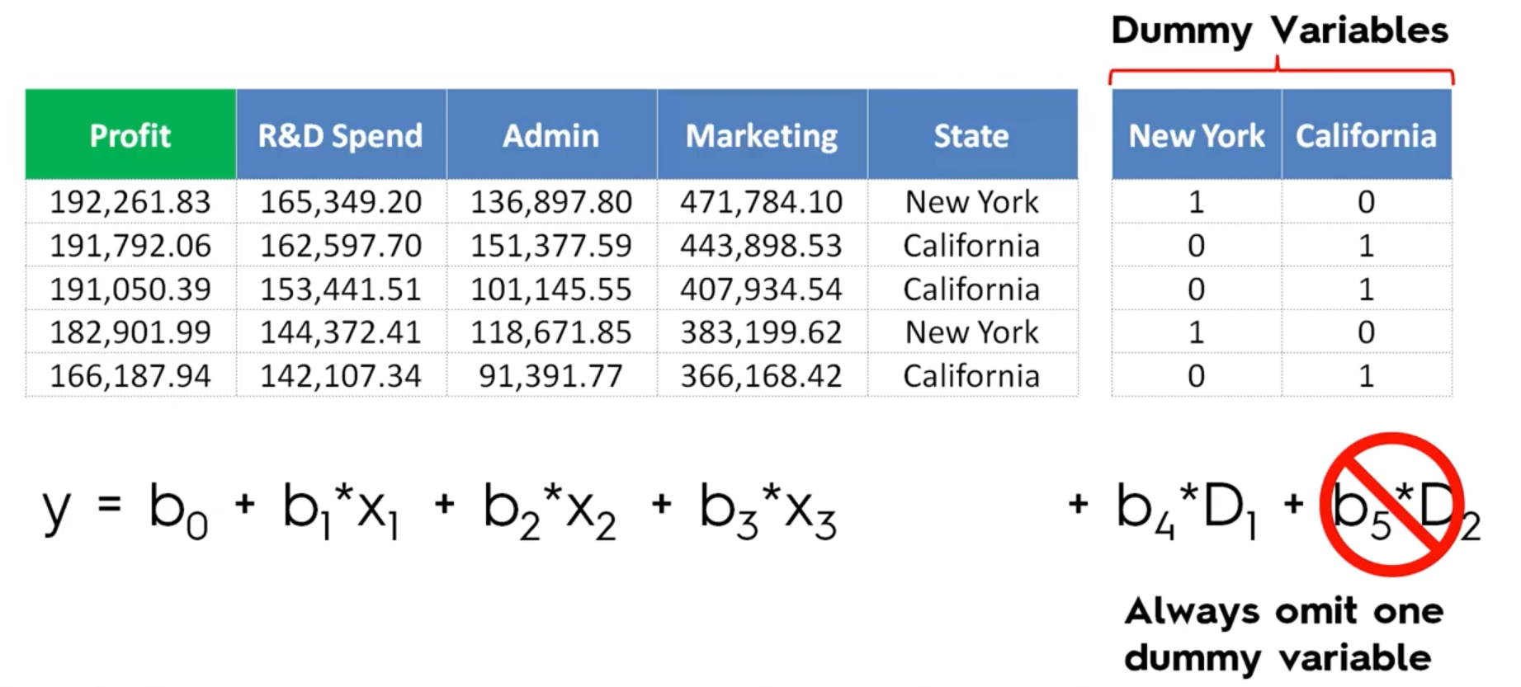
D1=1-D2 Multi-Colinearity

Slide 15
SVM – Support Vector Machine
Notes:
Non linear but continues model

Slide 17
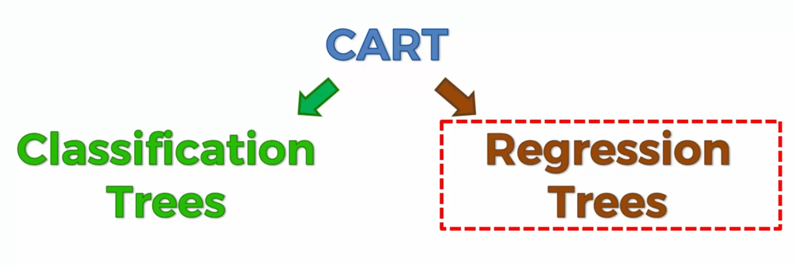
Classification and Regression Trees

Slide 18
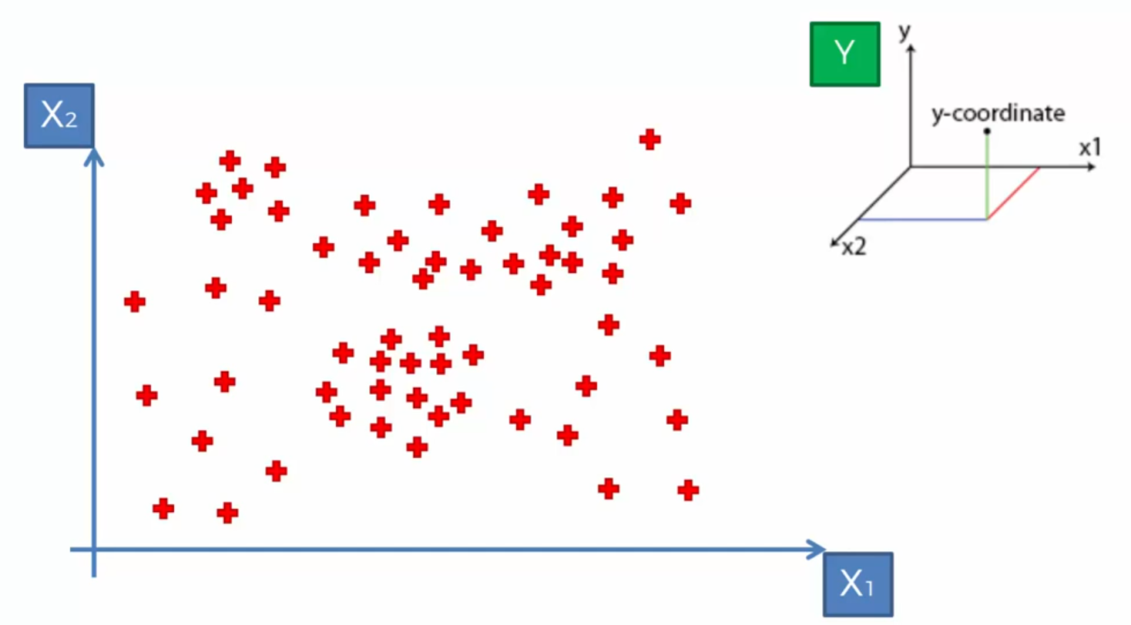
Decision Tree Intuition

Slide 19
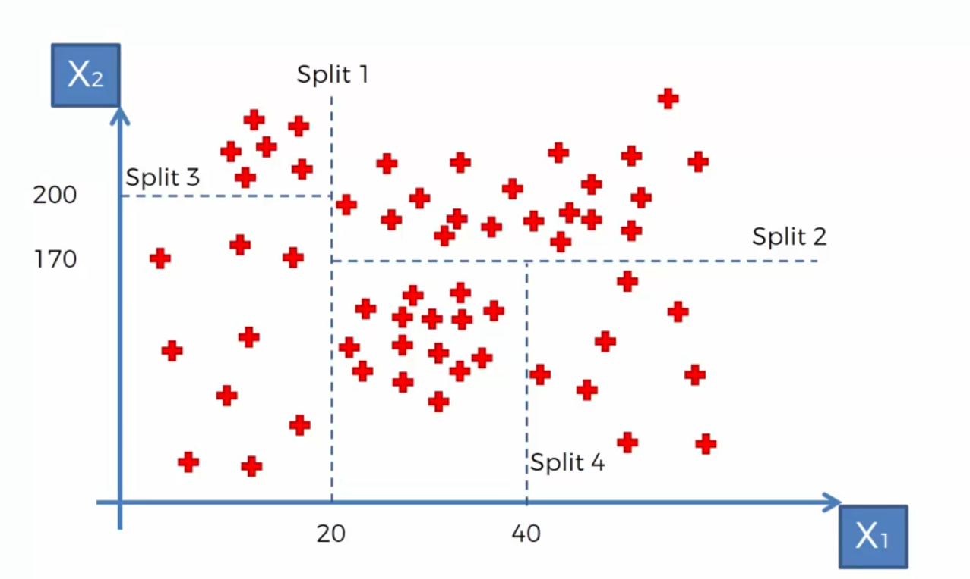
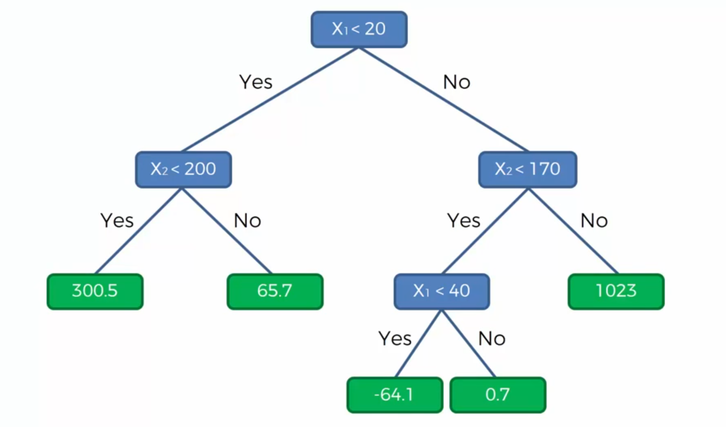
Notes:
Information Entropy… whether adding new split give us more info or not?

Slide 20
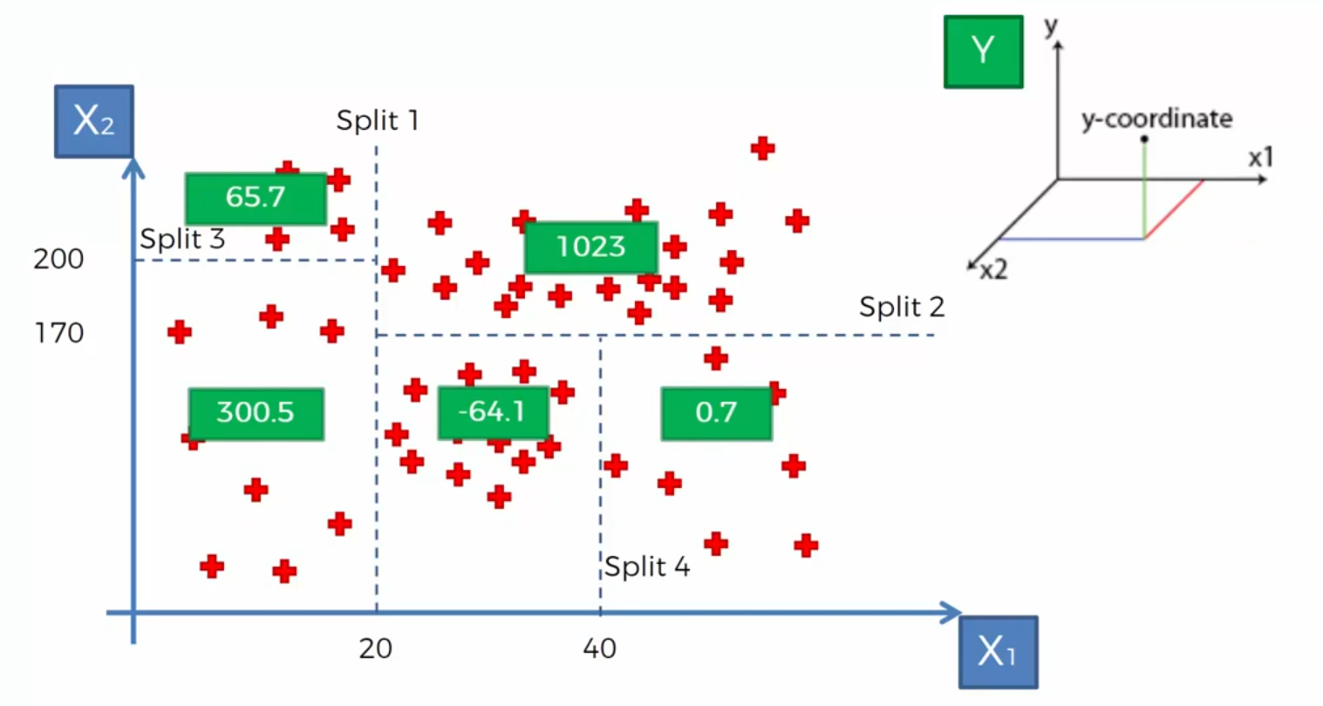
Decision Tree value for Regression models
Notes:
Non linear and not continues model

Slide 21
Decision Tree and Final output for Regression model
Notes:
Average of each partition will be the result of partition

Slide 23
Ensemble Learning
Bagging
Different independent sample
Random Forest
and for each sample you make a separate Decision Tree
Boosting
Weak learning
…

Slide 24
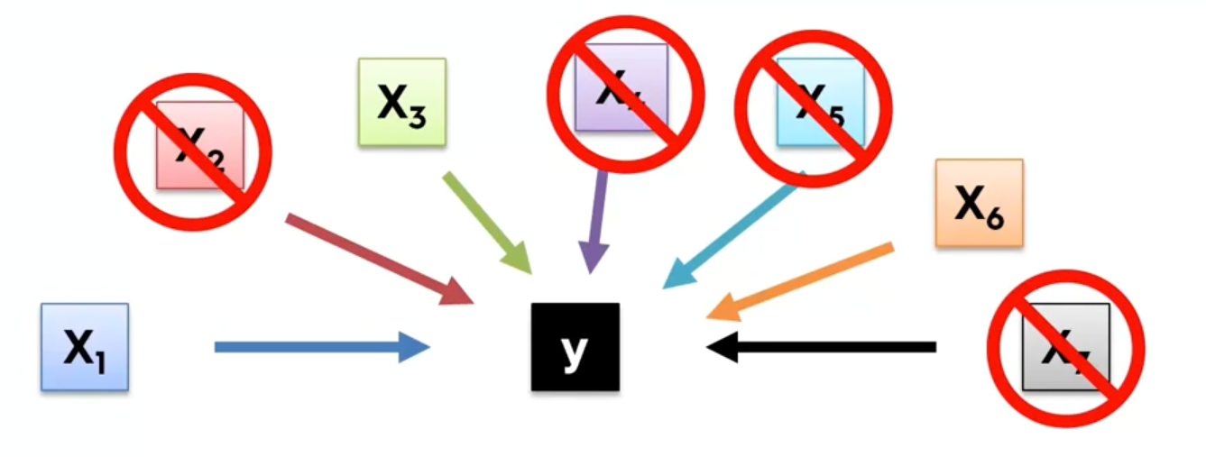
Building a Model
Why we don’t need to keep all columns?

Slide 25


Building a Model
Why we don’t need all the Features?
Garbage in Garbage out
Complexity and confusion

Slide 26
Building a Model
Feature Selection
All-in
Prior knowledge
You have to
Prepare for Backward Elimination
Backward Elimination
Forward Selection
Bidirectional Elimination
Score Comparison

Slide 27
Objectives and Overview
Predict the burned area of forest fires!
A reusable end-to-end Regression framework
EDA
Feature Selection
Feature Engineering
Training and Test Data selection
Modeling
Pipeline for each possible steps
Hyper Parameter Tuning
Evaluation

Slide 28


Thank You
Abbas Malekpour
Abbas.malekpour@gmail.com

